Slide 1
People First New Zealand – Ngā Tāngata Tuatahi
My Life
My Decisions
Notes:
Hello and welcome to our presentation: My life, my decisions.

Slide 2
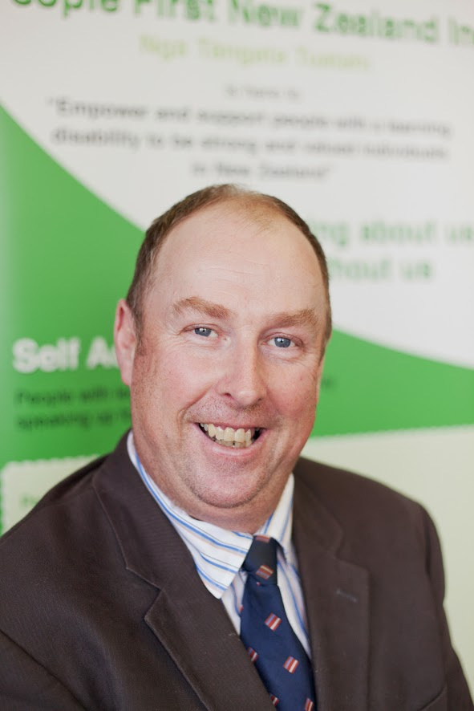
Introducing
Hamish Taverner
lives in Palmerston North
is Central Region President and National Chairperson
is a Special Olympics Global Messenger
Notes:
My name is Hamish Taverner.
I live in Palmerston North and I am People First’s national chairperson and the central region President.
I have nearly been the National Chairperson for 4 years. It has been amazing and a lot of meetings and helping other people.
I have lived in my own house for 16 years and I live with my cat Sooty.
I am also a Global Messenger for Special Olympics and I do swimming and boccia for my sports.
I have a part-time job doing office work at the Animal Breeding Trust.

Slide 3
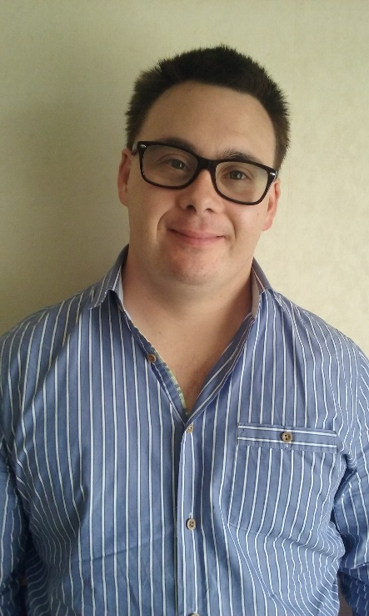
Introducing
Alex Snedden
Lives in Auckland
Lives in own flat with 3 flatmates
Working to become a deacon within the Catholic church
Vice-President of Northern region.
Notes:
Hi I am Alex Snedden and I live in Auckland.
I have 2 dogs.
I live in my own flat with 3 flatmates and I am the landlord.
I am working to become a Deacon within the Catholic church.
A Deacon is like a Minister.
I am the Vice-President of the Northern region for People First and I have 3 jobs.

Slide 4
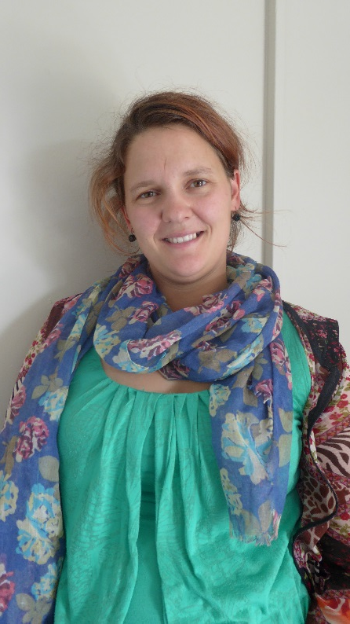
Introducing
Hazel Penton
Lives in Auckland
Lives in a big community service
Paid work and volunteer job
Special Olympics swimming and basketball
Notes:
Hello I am Hazel Penton and I live in Auckland.
I live with 3 flatmates in a big community service called Hohepa. There are around 50 other people there.
I have 2 dogs.
I work at Spotlight 3 days a week and have a volunteer job at the Salvation Army Family Store.
I also do swimming and basketball with Special Olympics and I like doing lots of craft work.

Slide 5
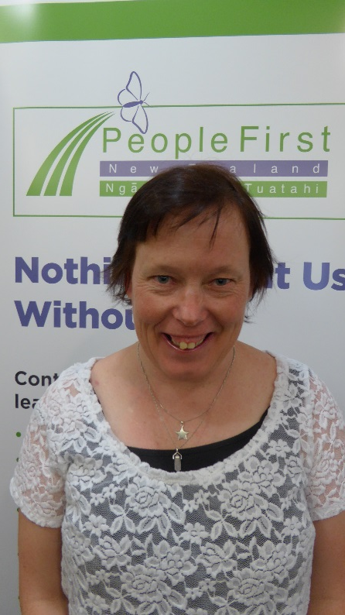
Introducing
Jodie Turner
lives in Tauranga and is the Midland Region President
lives in her own flat
starting to look for work
Notes:
Hi I am Jodie Turner and I am from Tauranga.
I am the Tauranga group President and the Midland Region President.
A couple of years ago I made the decision to go flatting and I love it.
It was an easy decision because I had been thinking about it for about 4 years. I have been in supported living now for over 2 years.
I didn’t like having staff all the time and I wanted to have my own flat.
I am also starting to look for work for when my time on the National Committee is up in August next year. I am doing this with the help of Workbridge.
Karaoke and dancing are 2 of my favourite hobbies.

Slide 6
A bit about People First NZ
Notes:
Today we want to talk about making decisions but first a bit about our organisation People First.
People First NZ was started in 1984.
It was supported by IHC for the first 20 years.
This is our old logo.

Slide 7
People First – Ngā Tāngata Tuatahi
Notes:
Since 2003 People First has stood on our own.
Now it is the members who lead People First.
In 2013 we celebrated being 10 years old.
Over the past 13 years we have grown better and stronger.

Slide 8
People First – Ngā Tāngata Tuatahi
Notes:
People First NZ is a Disabled Persons Organisation.
You can also say a DPO.
This means People First is here to make sure the voice of people with learning disability is heard.
It is a self advocacy organisation led by and for people with learning disability.
We have hundreds of members all over New Zealand.

Slide 9
Speaking Up - Our Voice
Notes:
People First NZ assists members to speak up about what we think needs to change to make New Zealand a better place for us to live.
Members get to speak to government officials, to local city councils and politicians.
People First gets lots of requests for members to be on advisory groups, councils and boards.
Being on these groups gives members the chance to:
speak up and have people listen
and to give thoughts and ideas to make changes.
Learning to speak up can help us make decisions to make other changes in our lives like moving out of residential services to go flatting with support.

Slide 10
Making Decisions
Notes:
People First assists members to run our own organisation :
by giving us information in easy read
By having meetings in different ways that suit us
By having Assistants who have good relationships with us so they can give us good assistance.
All these things assist us to make the decisions we need to within People First.

Slide 11
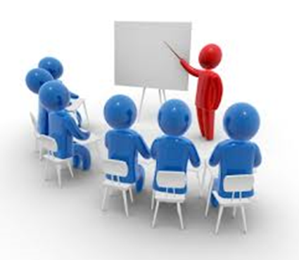
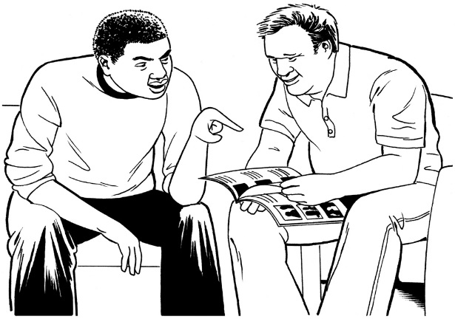
Services and Projects
Notes:
People First New Zealand also:
runs a Disability Information and Advice Service
has an Easy Read Translation Service called Make It Easy
does training courses through our education service Learn With Us and other project work.

Slide 12
The UN Convention
Notes:
All People First’s work is done in line with the UN Convention on the rights of disabled people.
The UN Convention guides People First.
It should guide you too.

Slide 13
The UN Convention
Notes:
Hands up if you know about the UN Convention
Keep your hands up if you have read it
Keep your hands up if you use it in your work

Slide 14
The UN Convention
Notes:
When the convention was being made there was a lot of talk about decision making
Disabled people said we can and we want to make our own decisions.
Sometime we might need support to do this and that’s Ok .
We don’t want others to be making our decisions and controlling our lives
The convention has given us a tool to make sure this doesn’t happen

Slide 15
Article 12 of the UN Convention
Notes:
Article 12 is being called the centre piece of the Convention.
Article 12 is about being treated equally by the law and says:
people with disabilities are to be respected by the law like everyone else
people with disabilities have their own rights to make choices about important things as everyone else
people with disabilities should have the support they need when making choices.

Slide 16
Things need to change
Independent but not alone
Notes:
In New Zealand, and in most other countries in the world, there are guardianship laws.
These laws make it ok for other people to make decisions on behalf of some disabled people
This needs to change
To see what other countries are saying have a look at Inclusion international’s global report on the right to decide called INDEPENDENT BUT NOT ALONE

Slide 17
Comment on Article 12
Notes:
The UN Committee has made a Comment to help counties with article 12.
In the comment they have said NO to any substitute decision making. Substitute decision making means: someone else making decisions for people with a disability.
This means most counties will have to look at what they do now and make big changes. Article 12 will mean big changes in New Zealand.
You can find this comment on the United Nations’ human rights website.
We need to remember that the all of the rights in the convention are for all disabled people not just some.
As Robert Martin heard a person with learning disability say in Africa: There are no half rights, only full rights.

Slide 18
Support or Control?
Notes:
For many years others have made decisions for us. While most people would be thinking they are being helpful it doesn’t feel good.
The law has been used to try and control us by people that are meant to support us. Some people have been stopped from getting married or having children or living where they want to.
Services often have rules that work for them but don’t work for us. Like making people who don’t choose to live together be flatmates and making people go to day bases when they want to stay home.
Think about if you had to live with someone you didn’t like and you could not change this.
Think about if you were forced to go somewhere when you don’t feel well.

Slide 19
NZ Disability Action Plan
Notes:
People First has been working with the other Disabled People Organisations and the Government to make the New Zealand Disability Action Plan.
We are really pleased that there is an action about supported decision making in it.
This means New Zealand will have to do some work on this over the next 4 years.

Slide 20
Making our decisions
Notes:
In the first part of the plan it talks about making my own choices.
It says:
I can make my own choices about what I want to do
I have the information and support I need to help me make choices in a way that I understand.
These words are really important to us.

Slide 21
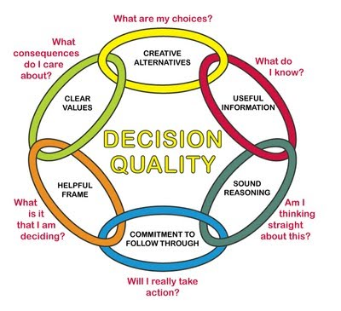
To make a decision
Notes:
To make choices we need:
to know what the choices are
have information in ways we can understand
know what will happen if we go ahead and what will happen if we do not go ahead
have time to think – not to be rushed
have people we trust to talk to and support us

Slide 22
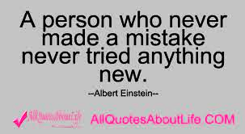
Its ok to make a mistake
Notes:
As Albert Einstein said: “A person who never made a mistake never tried anything new”
We think it is ok to make mistakes.
Support us when we make mistakes to learn from them.

Slide 23
A team
Notes:
Everyone can make decisions.
For people who find it hard to talk they can still show if they like something by smiling or do not like something by getting upset.
It’s our job to listen really hard.
It is good for some of us to have people who love and care for us to help us with decision making.
We do not know how supported decision making will work in New Zealand and overseas but we know that things will be changing.

Slide 24
What can people working in services do to assist with decision making?
Notes:
What can people working in services do to assist with decision making?

Slide 25
Do you ………..?
know about the UN Convention and use it in your work?
know what Article 12 says and the UN Committee comment on it?
teach the Convention to your staff?
Notes:
Do you:
know about the UN Convention and use it in your work?
know what Article 12 says and the UN Committee comment on it?
teach the Convention to your staff?

Slide 26
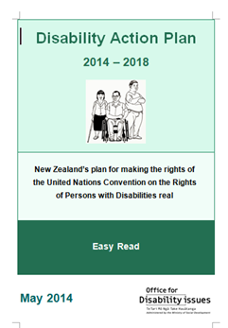
Do you ……..?
keep up to date with things like the New Zealand Disability Action Plan and what is in it?
Notes:
Do you:
keep up to date with things like the New Zealand Disability Action Plan and what is in it?

Slide 27
Do you ….?
give information in Easy Read and other ways that work for the people you support?
Notes:
Do you:
give information in Easy Read and other ways that work for the people you support?

Slide 28
Do you ….?
ask the question:
“What do you need to help you make your choices and decisions in your life?”
Notes:
Do you:
ask the question: “What do you need to help you make choices in your life?”

Slide 29
Do you ….?
tell people off when they make mistakes?
Instead of this, talk about what went wrong and assist them to learn from their mistake.
Notes:
Do you:
tell people off when they make mistakes?
Instead of this, talk about what went wrong and assist them to learn from their mistake.

Slide 30
Do you ….?
talk to the people you support about any changes that are happening in your service?
Make sure you also include others that love and care for the people you support.
Notes:
Do you:
talk to the people you support about any changes that are happening in your service?
Make sure you also include others that love and care for the people you support.

Slide 31
Do you …..?
work out ways to make sure people have control over and understand about their money as much as possible?
Notes:
Do you:
work out ways to make sure people have control over and understand about their money as much as they can?

Slide 32
Do you ….?
involve the people you support when hiring staff?
Notes:
Do you:
involve the people you support when hiring staff?

Slide 33
Self check list
How is your service doing?
Notes:
All these ideas have been put into the People First NZ‘s “How is your service doing?” self checklist.
We hope this checklist helps you to make sure its our decisions that make our good life.

Slide 34
Thank you for listening
Notes:
Thank you for listening today.
Thanks to the organisers of this conference for asking People First to speak.
I hope we have given you something to think about!
Enjoy the rest of the conference.
Thank you.

